Slide 1
6. Storage Operations
ADVANCED
OPERATIONS
TRAINING
© Copyright Scality 2022
RING 8.5

Slide 2
Storage Operations
At the end of this module, you will be able to …
… perform operations on disks, SSDs, servers
… and also understand failure impact and recovery.
Notes:
Last update: 20180410

Slide 3
Contents
Data Disks
Metadata Devices
Storage Nodes
Multi-geo

Slide 4
Data Disk
Managing data drives failure and recovery
RING 8.5

Slide 5
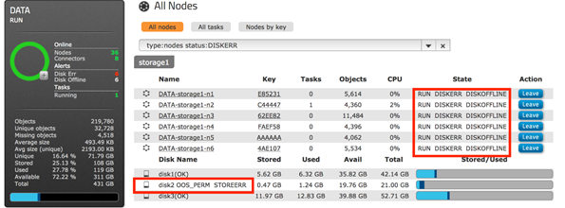
Data Disk Failure
Observations
The DATA RING remains green.
The disk is marked as OOS_PERM.
The DATA node processes on that
server indicate that a disk is OFFLINE.
Impact
No impact.
Limits
Simultaneous disk failures (before completion of first data rebuild) on more servers than allowed by the weakest DATA RING protection.
E.g.: On a RING of 12 servers using ARC9+3 and CoS2 → limited to simultaneous failures on 2 servers.
Customer actions
None required immediately, because objects are being rebuilt thanks to the auto-disk-repair task.
Notes:
RING color and Service Impact here are based on a healthy RING, without currently missing data.

Slide 6
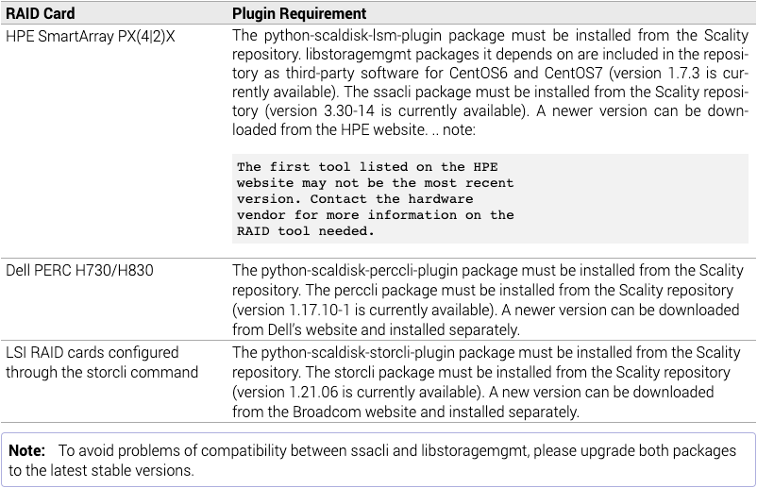
Replacing a Failed Data Disk (1)
Prerequisites
✔ RingSH is available on the supervisor server.
✔ The server manufacturer’s CLI tool for the storage controller is installed.
✔ The following packages and plugins are required for supported RAID cards (from 🔗RING 7.4.5 Scaldisk Tools Requirements):
✔ scaldisk has been installed and at the version of the latest RING release. To check, use:
✔ A new physical disk is available and ready to be inserted to replace of the failed one.
rpm -qa | grep scaldisk

Slide 7
Replacing a Failed Data Disk (2)
Recommended method with scaldisk
SSH to the storage server with the failed disk; set the variables to use during procedure:
Ensure the OOS_PERM flag is set on the disk:
➥ If the flag is not set, do it manually:
Switch on the LED of the disk to replace:
Replace physically the defective disk.
Replace logically the defective disk with scaldisk replace:
The disk is re-inserted into the Data RING and starts being used.
RING=<Name of the RING on which the disk must be replaced. E.g "DATA">
DiskName=<Logical Scality name of the disk that must be replaced. E.g "g1disk02">
scaldisk iods list | grep ${DiskName}
Warning: To prevent any data loss if multiple disks to replace:
Set the OOS_PERM flag one disk per server at a time.
Check that the missing objects counter equals 0 before moving to the next disk. From the Supervisor, run and check the output:
scaldisk iods set ${DiskName} OOS_PERM
# ringsh supervisor ringStorage ${RING} | grep Missing
Missing objects (bad or lost): 0
scaldisk identify -p
scaldisk replace
🗒 The new disk will only be filled with new data, either from the applications or the rebuild tasks: there is no process that re-balances data from one disk to another.

Slide 8
More Information on Disk Management
Documentation (including disk replacement without scaldisk): look up “Disk Management” in the Scality RING Operations Guides found at 🔗https://documentation.scality.com.
Related Knowledge Base Articles:
🔗Using Scaldisk Replace On OOS_TEMP Disk.
🔗Scaldisk Replace A Disk With An Unexpected Disk.
In case of issues while replacing a disk, create a P3 ticket at 🔗https://support.scality.com.

Slide 9
Data Disk Exercise

Slide 10
Exercise
Start a loop of random write operations to the RING.
“Break” a data disk (e.g: with ‘scaldisk iods set name OOS):
  How long before the disk is marked as OFFLINE/OOS_PERM/OOS_SYS ?
  Is there an impact on the writes ?
  What changes in the object counts on the Supervisor UI ?
Follow the procedure to replace the failed disk:
  If on a VM, skip the identify and RAID configurations steps.
  umount and destroy the partition first (‘parted <device> rm 1’) to “reset” the disk.

Slide 11
Metadata Device
Managing SSD|NVMe devices
failure and recovery
RING 8.5

Slide 12
Metadata Device Failure - Data RING (1)
Case 1. Multiple metadata devices per storage server.
Observations
The Data RING remains green.
Some disks are marked as OOS_TEMP ⬅ missing bizobj.bin files.
The Data node processes on that server indicate that some disks are OFFLINE.
Impact
No impact.
Limits
Simultaneous metadata device failures (before completion of the restoration of the first one) on more servers than allowed by the weakest Data RING protection.
E.g.: On a RING of 12 servers using ARC9+3 and CoS2 → limited to simultaneous failures on 2 servers.
Notes:
OOS_TEMP means the objects will not be rebuilt; until the meta device is restored.
bizobj.bin files are evenly distributed across the SSDs

Slide 13
Metadata Device Failure - Data RING (2)
Case 2. Only one metadata device per storage server.
Observations
The Data RING color changes to red, status RUN INCOMPLETE.
All Data disks on that server are marked as OOS_TEMP ⬅ missing bizobj.bin files.
As a result, all Data node processes on that server are OUT_OF_SERVICE.
Impact
No service interruption.
A drop in performance could be expected: same as missing one server.
Limits
Simultaneous metadata device failures (before completion of the restoration of the first one) on more servers than allowed by the weakest Data RING protection.
E.g.: On a RING of 12 servers using ARC9+3 and CoS2 → limited to simultaneous failures on 2 servers.

Slide 14
Metadata Device Failure - Summary
Fill in the matrix and conclude
Scope | Impact | Limitations if no impact | Actions
DATA RING
META RING
S3C
XDM/Zenko
Conclusion

Slide 15
Metadata Device Recovery
Although a SSD failure is a hardware issue and has no service impact, create a P3 ticket at https://support.scality.com to request an ad-hoc procedure and assistance with the replacement of the device.

Slide 16
Storage Server Operations
Manage planned and unplanned events
RING 8.5

Slide 17
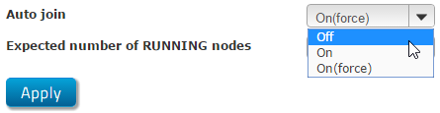
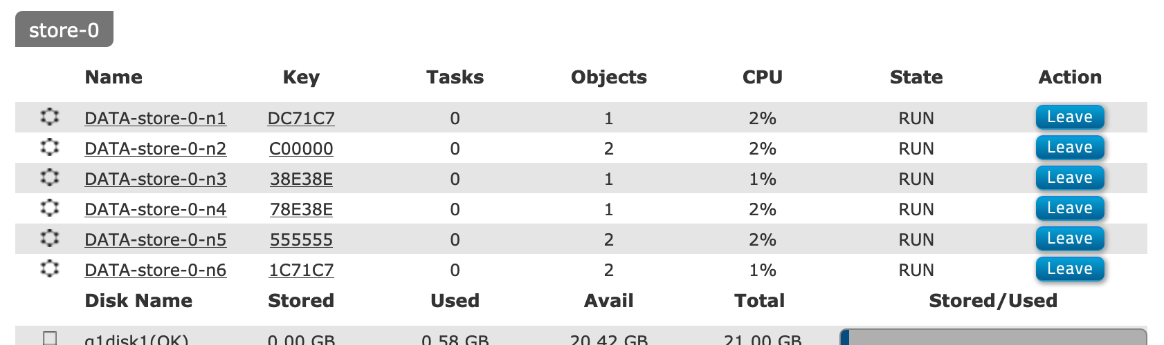
Stopping a Storage Server
Disable auto-join:
Leave the nodes on the server:
Stop the services on the server (CentOS|RedHat 7):
Shutdown or reboot the server, whatever is required by the operation.
systemctl stop scality-node
systemctl stop scality-sagentd
systemctl stop scality-srebuildd

Slide 18
Starting a Storage Server
The Scality processes are configured to start automatically when a server boots after a shutdown.
Step 1. is only required if the server was not shut down.
Start the services on the server (CentOS|RedHat 7):
If auto-join is set to On on all RINGs, there’s nothing else to do: the nodes will join automatically.
If not, join the nodes manually to their RINGs.
systemctl start httpd
systemctl start scality-srebuildd
systemctl start scality-sagentd
systemctl start scality-node
🗒The nodes go from OFFLINE status to LOADING. During the latter, they are loading their records from bizobj.bin files to memory: they “remember” the objects they have stored before the shutdown.
This step can take some time depending on the number of objects per disk.
Once they are done, their status changes to OUT_OF_SERVICE.

Slide 19
Server Monitoring
Hardware:
Operating system RAID 1 volume state
RAID card cache status
Power supply status
OS:
Track /var usage
TCP retransmits
Load average
Swap utilization

Slide 20
Rebuild Task - Replication
s5-n4 runs a rebuild task:
For Key₂₀, s5-n4 figures out Key₂₁.
s5-n4
findSuccessor(Key₂₁)
Key₂₁
vers=128
Key₂₀
vers=128
Key₂₁
vers=64
check(Key₂₁)
IP:Port, Key_{s2-n2}
s5-n4 does a findSuccessor(Key₂₁) and finds s2-n2.
EXISTS, vers=64
s2-n2
s5-n4 sends a check(Key₂₁) to s2-n2:
  Existence,
  Version, etc
PUT(Key₂₁,data,metadata)
If the reply is not OK:
  s5-n4 sends a PUT to update Key₂₁ which will update not only the data but also the record of Key₂₁
s4-n3
Key₂₂

Slide 21
Rebuild Task - ARC
Example with ARC4+2
get(Key₇₅)
get(Key₇₃)
⚙
srebuildd
on server s5
get(Key₇₂)
get(Key₇₀)
Key₇₀
vers=128
check(Key₇₁)
s5-n4
get(Key₇₁)
srebuildd is local to server s5.
srebuildd issues k+m findSuccessors and checks, but only need to GET k chunks to reconstruct.
Key₇₁
vers=64
Key₇₁
vers=128
EXISTS, vers=64
sproxyd and sfused emulate srebuildd when processing a request for an ARC object with problematic* chunks.
s2-n2
Notes:
(*) problematic = missing, lower version, oos, bad

Slide 22
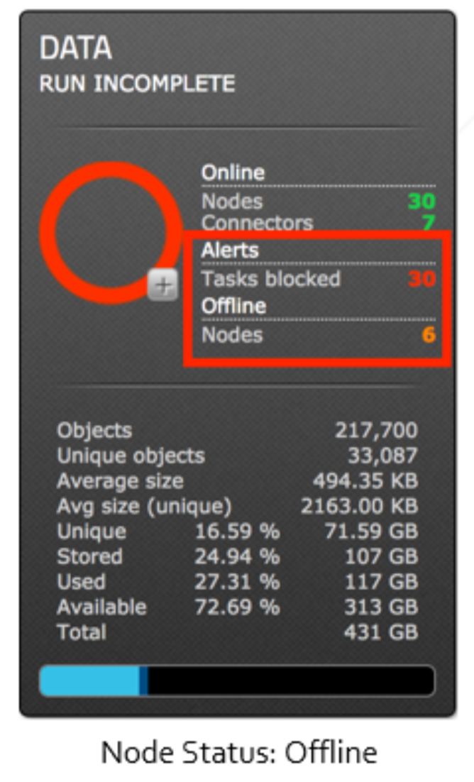
Storage Server Failure - Data RING
Observations
The Data RING color changes to red with the status INCOMPLETE.
The remaining Data nodes indicate TASKS_BLOCKED:
  The Split Detection feature blocks Rebuild and Purge tasks.
Impact
No service interruption.
Possible drop in performance.
Limits
Simultaneous failures (before recovery of the first one) of more servers
than allowed by the weakest Data RING protection.
E.g.: more than 2 servers on a RING of 12 servers using ARC9+3 and CoS2.
Actions
If the outage is expected to last for more than two days, create a P3 ticket
at 🔗https://support.scality.com as some tuning might be needed.
Notes:
RING color changes and Service Impact here are based on a healthy RING, without currently missing data.
Beware of the impact blocking purge as on capacity.

Slide 23
Storage Server Recovery - RING-side
If the server comes back intact (hardware, system, software and configuration):
  The Scality services start automatically when the server boots.
  If auto-join is set to On on all RINGs, there’s nothing else to do: the nodes will join automatically.
  If not, join the nodes manually to their RINGs.
  In any case, the self-healing tasks run automatically:
    The Rebuild task will update existing objects that were modified;
    and the Balance task will correctly move the objects misplaced during the outage.
If the server requires restoration, create a P3 ticket at 🔗https://support.scality.com to request an ad-hoc procedure and assistance with the reinsertion of the server.

Slide 24
Balance Task
s5-n4
0BE2
Server 7
s4-n1 is responsible for all keys between 0BE3 and 1C9A.
One of these two situations happens:
  Server 7 is added to the RING.
OR
  Server 7 comes back from a downtime.
s7-n3
13F8
BALANCE (DST)
s7-n3 has a key that places it between s5-n4 et s4-n1.
  s4-n1 has its theoretical key range reduced.
  s7-n3 takes over the theoretical key range 0BE3 to 13F8.
All the objects with keys on that key range need to move to s7-n3:
  That’s what we call BALANCE.
s4-n1
1C9A
BALANCE (SRC)
Notes:
This happens at 5 other locations in the Ring, the successor node being on different servers.

Slide 25
Proxy Task
s5-n4
0BE2
GET foo.bar ➡ 0F95
CONNECTOR
The RING is in a BALANCE situation.
BALANCE can take a long time:
CHECK(0F95)
  Requests arrive for objects that have not moved yet.
  s7-n3 will claim ownership but s4-n1 still has the data.
0F95
🔀 range:IP:Port
The BALANCE (SRC) send periodical set_proxy(range) requests to its BALANCE (DST) node.
BALANCE (DST)
s7-n3
13F8
CHECKs and following requests are “proxied” to the SRC.
CHECK(0F95)
During reads, the DST node writes locally the object, saving one balance.
set_proxy(key range)
s4-n1
1C9A
BALANCE (SRC)
Notes:
This happens at 5 other locations in the Ring, the successor node being on different servers.

Slide 26
Storage Server Exercise

Slide 27
Exercise
Start a loop of random write operations to the RING.
Shutdown a storage server:
  What happens on the Supervisor ? What does it mean for the RINGs ?
  Is there an impact on the writes ? The reads ?
Bring back the server online:
  What happens on the Supervisor ? What does it mean for the RINGs ?
  Is there any manual operation ? What about automatic operations ?
  Is there an impact on the writes ? The reads ?

Slide 28
2-site Operations
Managing site loss and recovery
RING 8.5
Notes:
A “site” can be defined as an environment with its own power and network. Different buildings on the same campus, different buildings in different parts of a city, or different rooms in the same building with different power circuits and network wiring could all be considered as “sites”.

Slide 29
2-site Operations
Data RING
RING 8.5

Slide 30
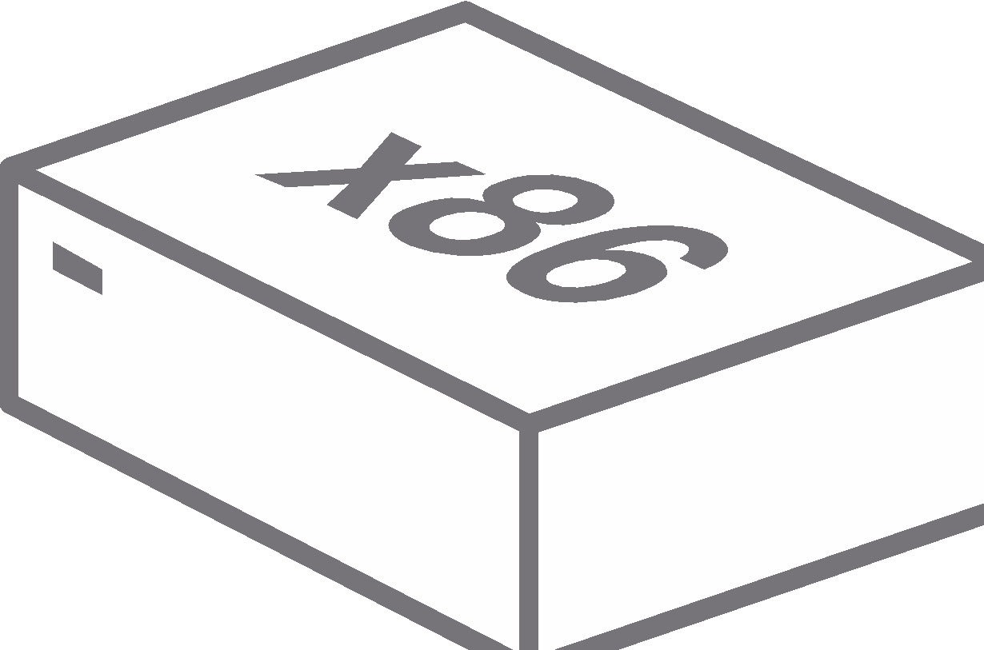
2-site Data RING Overview
Site A | Site B
DATA RING
The sites have:
same number of servers.
same disk capacity.
Data protection: ARC5+7, CoS3.
Can withstand up to:
1 site + 1 server offline, if num_servers >= 12.
1 site + 1 disk offline , if 6 <= num_servers < 12.
Notes:
withstand = have all data still available in read/write

Slide 31
Shutting down Scality Services on a Site
Stop the connectors on the selected site: see the connectors’ type-specific stop procedure.
Stop the storage servers on the selected site: see the stop procedure for storage servers.

Slide 32
Starting Scality Services on a Site
Start the storage servers on the selected site: see the start procedure for storage servers.
Wait for the RINGs to stabilize: no LOOP, SPLIT or NOT_STABILIZED state.
Start the connectors on the selected site: see the connectors’ type-specific start procedure.

Slide 33
Site Failure - Data RING
Observations
The Data RING color changes to red with the status INCOMPLETE.
The remaining Data nodes indicate TASKS_BLOCKED:
  The Split Detection feature blocks Rebuild and Purge tasks.
Impact
All data is still available for the connectors properly configured.
Degraded storage service.
Actions
If the outage is expected to last for more than two days, create a P2 ticket
at 🔗https://support.scality.com as some tuning might be needed.
Site A | Site B
Notes:
RING color changes and Service Impact here are based on a healthy RING, without currently missing data.
Beware of the impact blocking purge has on capacity.

Slide 34
Site Recovery - Data RING
If the site requires restoration, create a P2 ticket at 🔗https://support.scality.com to request assistance.
If the site comes back intact (hardware, system, software and configuration):
  The Scality services start automatically when the servers boot.
  If auto-join is set to On on all RINGs, there’s nothing else to do: the nodes will join automatically.
  If not, join the nodes manually to their RINGs.
  In any case, self-healing tasks run automatically:
    The Rebuild task will update existing objects that were modified;
    and the Balance task will correctly move the objects misplaced during the outage.
  Make sure that the RING stabilizes: no persisting LOOP, SPLIT or NOT_STABILIZED state.

Slide 35
Split Brain - Data RING
Site A | Site B
Observations
The RING is split into two half-size local Data RINGs with the status INCOMPLETE.
The Data nodes on both sites indicate TASKS_BLOCKED:
  The Split Detection feature blocks Rebuild and Purge tasks.
Impact
All data is still available for the connectors properly configured.
Degraded storage service.
Actions
Choose a primary site:
  configure the application.s to use only the connectors on
  that site;
  stop the connectors on the secondary site.
If the outage is expected to last for more than two days, create a P2 ticket at 🔗https://support.scality.com as some tuning might be needed.
Site A | Site B
Notes:
RING color changes and Service Impact here are based on a healthy RING, without currently missing data.
Beware of the impact blocking purge has on capacity.

Slide 36
Split Brain Recovery - Data RING
The RINGs merge automatically to re-form the original RING.
The self-healing tasks run automatically:
  The Rebuild task will update existing objects that were modified;
  and the Balance task will correctly move the objects misplaced during the outage.
Make sure that the RING stabilizes: no persisting LOOP, SPLIT or NOT_STABILIZED states.
Start the connectors previously stopped on the secondary site.

Slide 37
2-site Operations
Failure Management Summary
RING 8.5

Slide 38
Site Failure - Summary
Fill in the matrix and conclude
Scope | Impact | Limitations | Actions
DATA RING
META RING
S3C
XDM/Zenko
Conclusion

Slide 39
Split Brain/Isolated Site - Summary
Fill in the matrix and conclude
Scope | Impact | Limitations | Actions
DATA RING
META RING
S3C
XDM/Zenko
Conclusion

Slide 40

QUESTIONS ?

